Slide 1

Alternative stable states, phase shifts, catastrophic transitions
Vincent Jansen
vincent.jansen@rhul.ac.uk

Slide 2
Outline
Alternative stable states in coral reefs
Phase shifts and alternative stable states
Bee decline
Learning outcomes

Slide 3
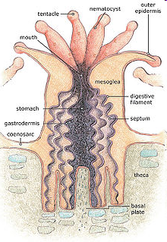
Coral Reefs
Coral reefs are made out of colonies of “polyps”. Reef building corals belong to the phylum Cnidaria
Occur in nutrient poor waters
They have tentacles to capture prey
Polyps secrete calcium carbonate, that accumulate and forms the reef
Reproduction mainly asexual through budding
Notes:
Cnidaria (jellyfish, anemones, hydroids).

Slide 4
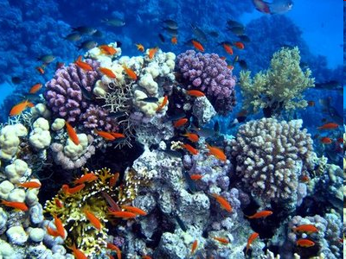
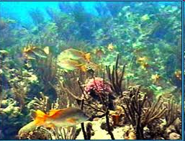
Coral Reefs
Coral reefs are highly diverse both in terms of corals as in other marine animals

Slide 5
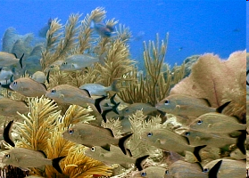
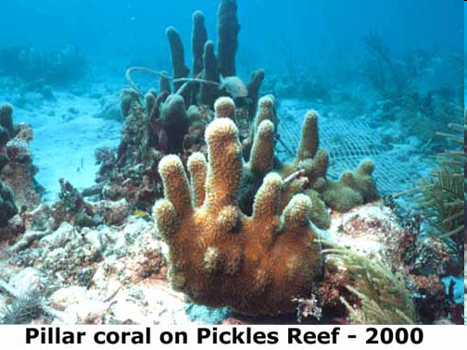
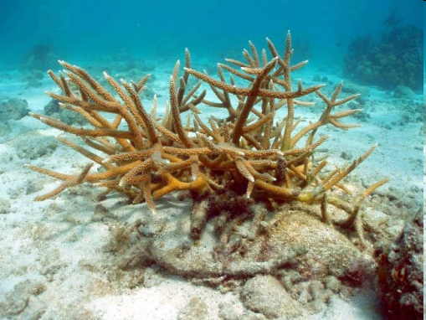
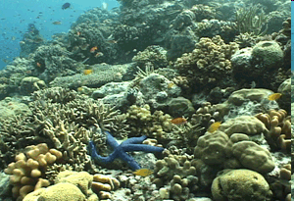
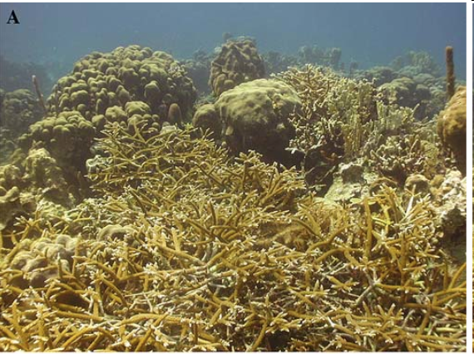
Notes:
Stag horn (bottom lef) pillar coral (top right)

Slide 6
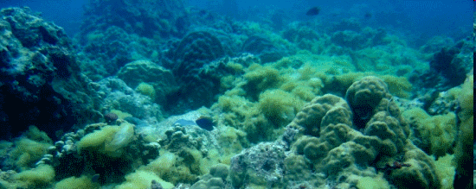
Coral Reefs
Corals compete for space with algae and macroalgae
If space opens up all players will try to fill it
Algae and macroalgae can overgrow a coral, coral can invade algal turfs

Slide 7
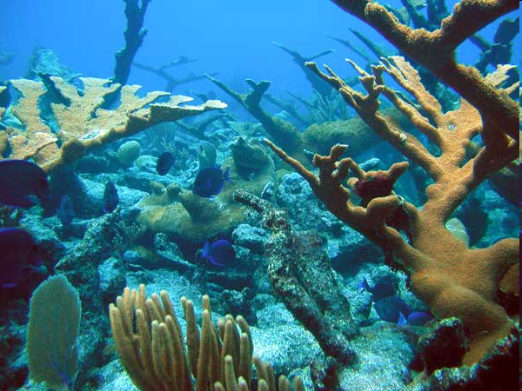
Blue tangs swimming in an elkhorn coral forest

Slide 8
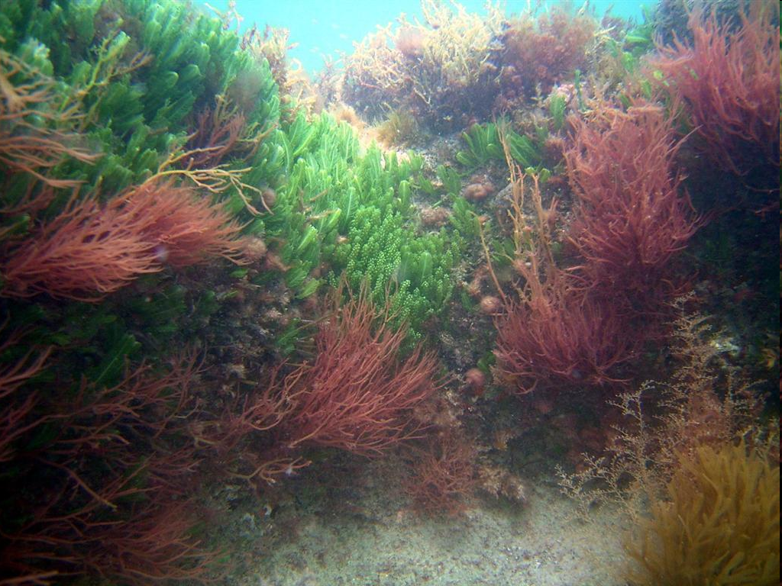
Coral overgrown with macroalgae

Slide 9
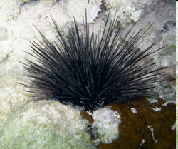
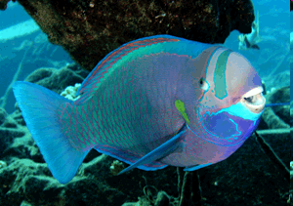
Coral reefs
Even though algae can overgrow coral, this normally is prevented through herbivores, who feed on the macroalgae
Diadema antillarum
(long spined sea urchin)
Parrot fish

Slide 10
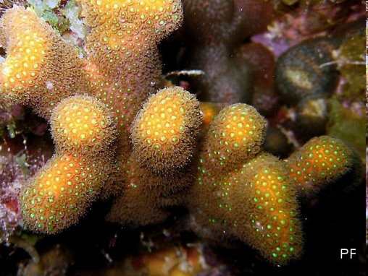
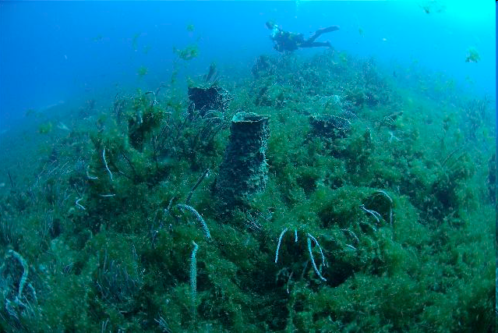
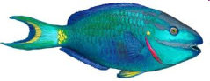
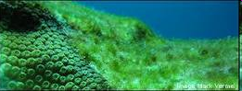
Simplified Coral Reef Ecology
Overgrowing
macroalgae
coral
Vegetative
spread
Colonisation dead coral
Overgrowing
Grazing
algal turf
herbivores

Slide 11
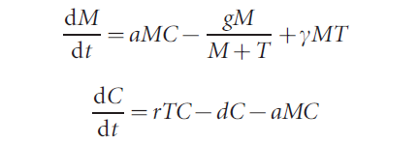
The same information, put in a model
with T+M+C=1
M, C and T describe the amount of space covered by Macroalgae, algal Turf and Coral
From: Mumby et al. Nature (2007)

Slide 12
Isoclines for the coral reef model
C
M
In the model, changing the amount of grazing, which determines the death rate of the macroalgae, is much the same as reducing the carrying capacity of the macroalgae.

Slide 13
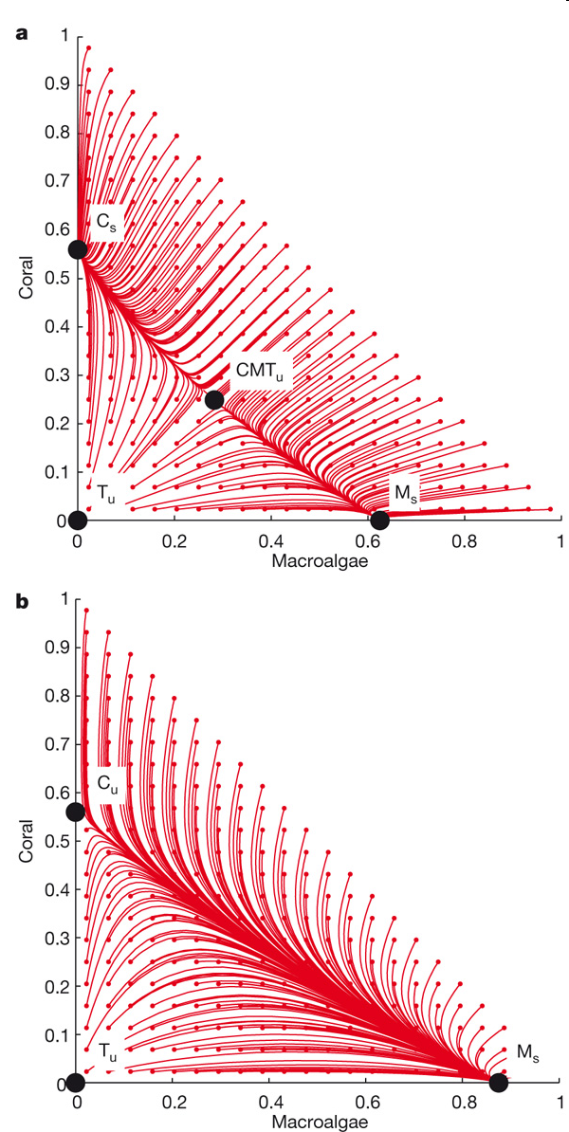

Slide 15
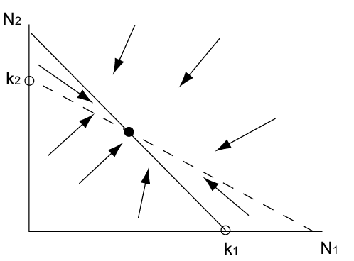
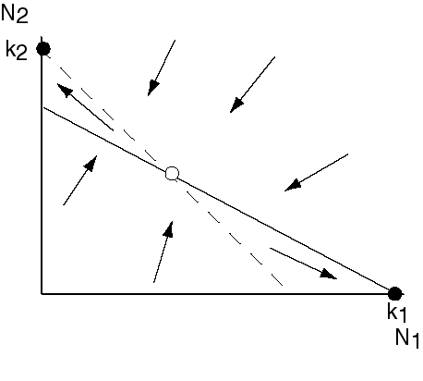
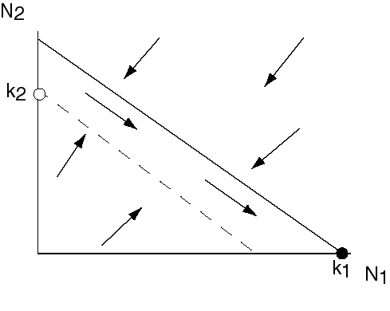
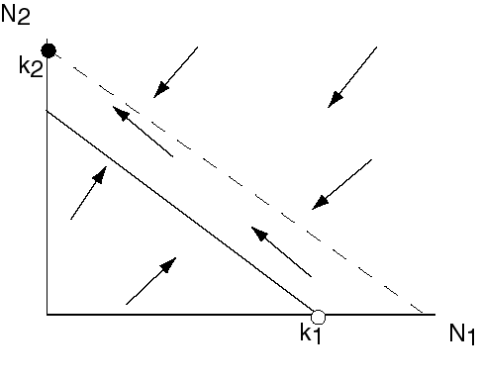
The outcomes of competition
Species 1 excludes 2
Species 2 excludes 1
Coexistence
Alternative stable states

Slide 16
Graphical method
to establish the outcome of competition
Mark the position of the carrying capacities on the appropriate axes
Draw the isoclines
If the isoclines do not intersect, the competition will lead to the equilibrium associated with the topmost isocline
If the isoclines do intersect, draw a straight line between the carrying capacities. If the intersection of the isoclines is positioned above this line the two species will coexist.
If the intersection of the isoclines is positioned below this line two alternative stable states (the carrying capacities) exist

Slide 17
Practical 2: Make a 1 parameter bifurcation diagram of the Lotka Volterra competition model.
If you have already done that: Investigate the phase portrait for the model in the Mumby et al. paper

Slide 18
What happens if we change the carrying capacity?
k₁/α
k₁/α
k₁/α
k₁
k₁
k₁

Slide 19
Phase shift
N₂ only
N₁ and N₂
N₁ only
N₂
k₂α
k₂/β
k₁

Slide 20
Phase shift
N₂ only
N₁ and N₂
N₁ only
N₁
k₂α
k₂/β
k₁

Slide 21
Other option if we change the carrying capacity (for different α and β)

Slide 22
Alternative Stable States, Catastrophic transition
N₂
N₁ or N₂
N₂
N₁
k₂/β
k₂α
k₁

Slide 23
Alternative Stable States, Catastrophic transition
N₁
N₁
N₁ or N₂
N₂
k₂/β
k₂α
k₁

Slide 24
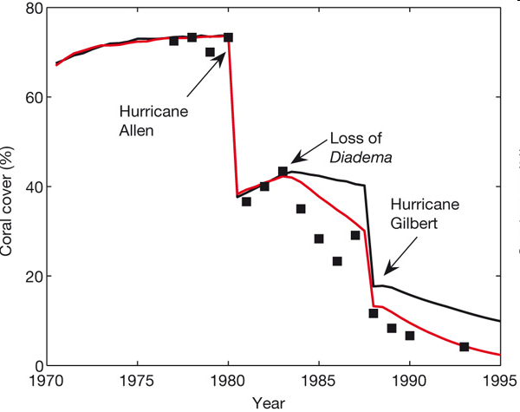
Coral cover in Jamaican reefs
Predictions are denoted by lines and empirical data are denoted by black squares
Notes:
Predictions are denoted by lines and empirical data are denoted by black squares. The model that was run with a median algal–coral overgrowth rate of 8 cm2 yr-1 is shown with a black line and the upper rate of 14 cm2 yr-1 is shown with a red line. 1983 Massive disease induced mortality in the sea urchins

Slide 25
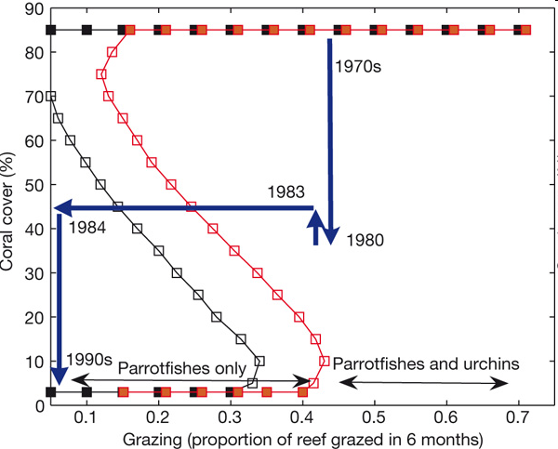
Data explained using alternative stable states
Notes:
Stable and unstable equilibria are denoted by solid and open squares, respectively. Black denotes 8 cm2 yr-1, red denotes 14 cm2 yr-1. Blue lines, marked with appropriate dates, represent model predictions of the trajectory of reefs in Jamaica (see also Fig. 1).

Slide 26
Data explained using alternative stable states
Notes:
Stable and unstable equilibria are denoted by solid and open squares, respectively. Black denotes 8 cm2 yr-1, red denotes 14 cm2 yr-1. Blue lines, marked with appropriate dates, represent model predictions of the trajectory of reefs in Jamaica (see also Fig. 1).

Slide 27
Coral reef recovery
In the early 1980’s Caribbean reefs experienced a sudden shift from coral dominated reefs to reefs with substantial macroalgae populations
This followed a time of chronic fishing of herbivores, hurricane damage and a die-off of Diadema antillarum in 1983
Although Diadema beginning to return in some places, reef recovery is patchy and many reefs still have not recovered to previous levels of coverage

Slide 28
Catastrophic transitions: management implications
If coral reefs, or other ecosystems have alternative stable states, this has important management implications.
In general, prevent large perturbations and manage so that the basin of attraction of the desirable state is largest
For instance, through limiting overfishing of herbivores

Slide 29
Climate change
It is now being realised that this also has important implications for climate change
With a changing climate it is not inconceivable that slow climatic changes cause transitions
See Verges et al. (2014) who argue that climate change can lead to phase transitions in temperate marine ecosystems

Slide 30
Generic situation
Bifurcation diagram of the metapopulation with rescue effect
p
Eigenvalue is 0 at this point
m
A fold bifurcation (also called saddle-node)

Slide 31
Generic situation
Codim 2 Bifurcation diagram of LV competition model
k₂α
k₁
k₂/β
k₂

Slide 32
Codim 2 Bifurcation diagram of LV competition model
k₁
N₂*
k₁=k₂α
k₁=k₂/β
k_{1/}/α
k₁β
k₂
k₂

Slide 33
Practical 2: An analysis of the codim 2 cusp bifurcation.

Slide 34
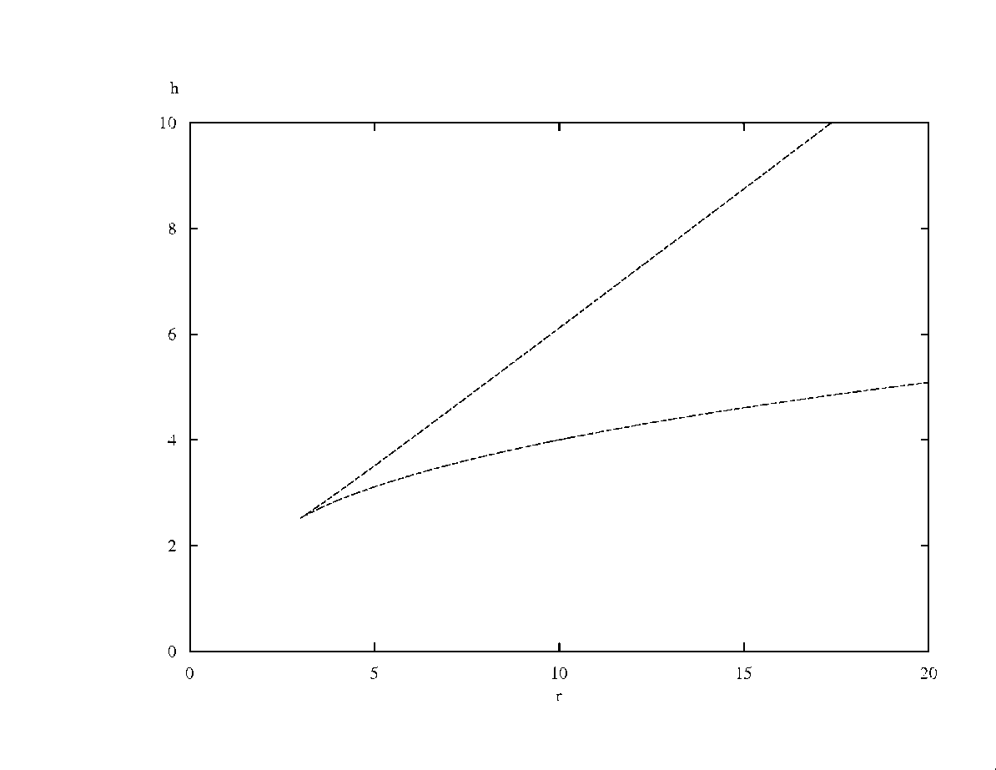
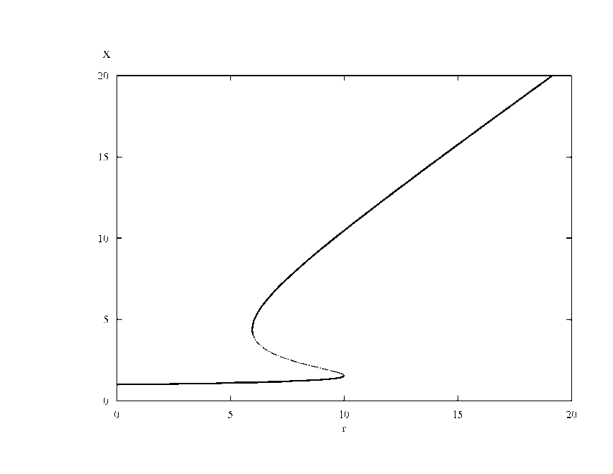
Generic situation
Generic codim 2 Bifurcation diagram
This is a cusp bifurcation
h
x
r
r

Slide 35
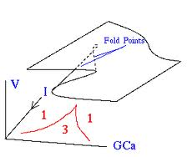
Generic situation
Generic codim 2 Bifurcation diagram
This is cusp bifurcation
h
x
r
r

Slide 36
Alternative stable states are found in vary different ecosystems:
Lakes
Deserts
Woodlands
Fisheries
Coral reefs
See review Scheffer in Nature 2001

Slide 37
Evidence
Although a compelling story, it is not universally accepted that the decline of coral reefs is caused by alternative stable states.
One of the problems that it is hard to show in a real ecosystem that there are multiple stable states
See See Mumby et al. Oikos (2013), also Dudgeon et al. MEPS (2011)

Slide 38
Evidence
In general, it is difficult to show this conclusively, as
Catastrophic shifts are rare events
Statistic methodology underdeveloped
to demonstrate alternative stable states you need to
Have repeated shifts
Show it plausible there are alternative stable states (fit data using models)

Slide 39
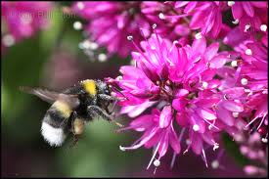
Bee decline
Insects pollinate about 75% of crop species and enable reproduction in up to 94% of wild flowering plants
One in 3 mouthfuls of food
depends on bee pollination

Slide 40
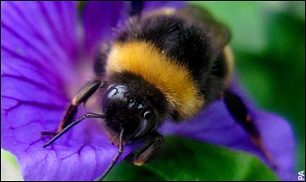
Bee decline
Pollinators are declining in many regions:
USA: 59% loss of colonies 1947-2005
Central Europe: 25% loss 1985-2005
UK: 10 of the 16 bumblebee species are declining, 6 are stable/increasing

Slide 41
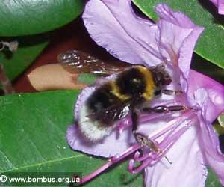
Bee decline
The reasons for bee decline are unclear and hotly debated.
Parasites, diseases, land use, invasive species, climate change and pesticide use have all been suggested as causes
None has been identified as a sole cause.

Slide 42
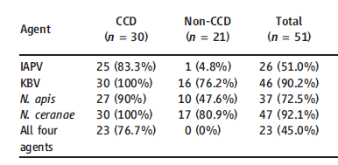
Why the cause of bee decline is so difficult to find
Prevalence of 4 diseases in collapsing colonies
Cox-Foster et al. Science (2007): 318, 283-287
Notes:
Israeli Acute paralysis virus
Kashmir Bee virus
Nosema

Slide 43
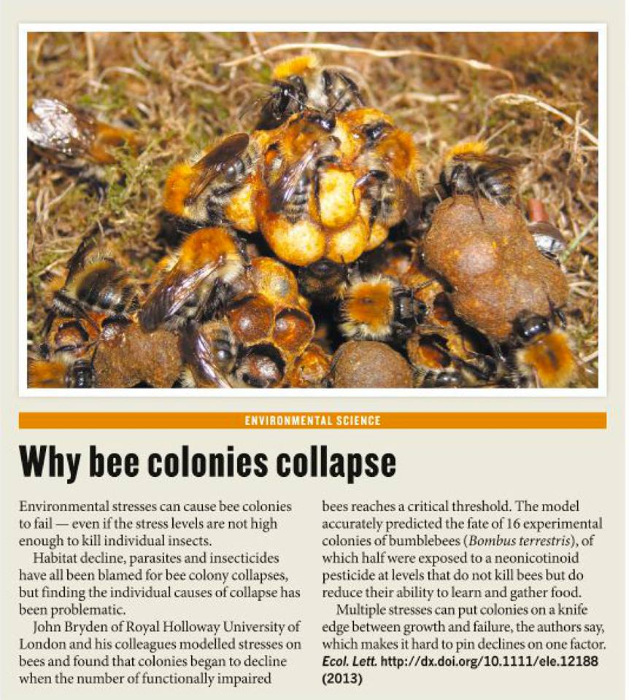
Notes:
'A healthy Bombus pascuorum colony with workers tending brood. Globally bee populations are in decline, yet there does not appear to be one primary cause. On page xxx of this issue Bryden et al. show how bumblebee colonies can fail if exposed to low levels of a neonicotinoid pesticide. Rather than killing bees outright, this exposure causes individual bees stress and affects their foraging, this in turn impairs colony function and ultimately causes colonies to fail. Since many factors can cause stress, this explains why it has been so difficult to identify a single primary cause for bee declines.'

Slide 44
Nature, 16/10/2013 highlights a paper:
Notes:
'A healthy Bombus pascuorum colony with workers tending brood. Globally bee populations are in decline, yet there does not appear to be one primary cause. On page xxx of this issue Bryden et al. show how bumblebee colonies can fail if exposed to low levels of a neonicotinoid pesticide. Rather than killing bees outright, this exposure causes individual bees stress and affects their foraging, this in turn impairs colony function and ultimately causes colonies to fail. Since many factors can cause stress, this explains why it has been so difficult to identify a single primary cause for bee declines.'

Slide 45
Effects of exposure of sublethal pesticides
A number of models were made. One of the models has a death rate that has positive density dependence
The positive density dependence reflects that larger colonies survive better because these colonies function better (e.g forage better, are better at temperature control, hygiene, etc.)
This creates alternative stable states
Bryden et al. Ecology Letters (2013)

Slide 46
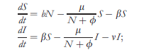
Effects of exposure of sublethal pesticides
birth
S: healthy bees
I: bees impaired by pesticide
N:S+cI: effective colony size
Note: per capita death rate density dependent.
death
impairment
death through pesticide
Bryden et al. Ecology Letters (2013)

Slide 47
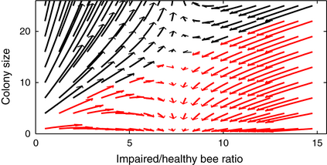
Colony dynamics
Bryden et al. Ecology Letters (2013)
Notes:
Phase plane demonstrating multiple outcomes in the dynamics of the SLS Model between colony growth and failure. Trajectories denote 20 days of the model starting from different initial conditions (see Methods for more information) and are depicted by arrows coloured according to whether they lead to continued growth (black arrows) or colony failure (red arrows). Parameters were the same as those in Fig. with β = 0.12.
© This slide is made available for non-commercial use only. Please note that permission may be required for re-use of images in which the copyright is owned by a third party.

Slide 48
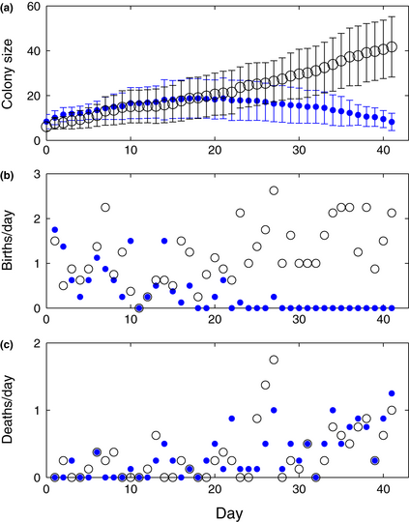
Effects of exposure of sublethal pesticides
Colonies were exposed to sublethal pesticide doses (blue). Control (grey) colonies do not fail
Bryden et al. Ecology Letters (2013)

Slide 49
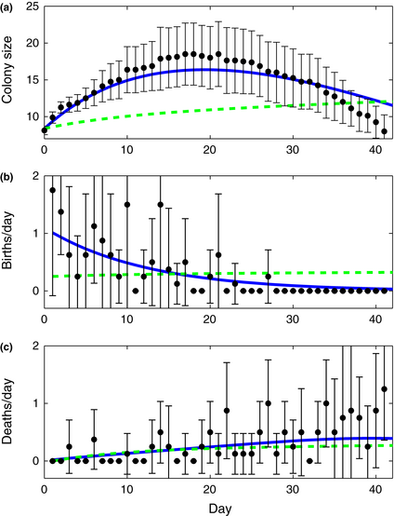
Effects of exposure of sublethal pesticides
This model (blue line) fits the data best, and better than a model with a linear death rate
Note: as the colony declines the total death rate increases
Bryden et al. Ecology Letters (2013)

Slide 50
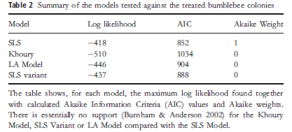
Effects of exposure of sublethal pesticides
A number of models was made. The one with the best fit is assumed to be the one that is most correct
Bryden et al. Ecology Letters (2013)

Slide 51
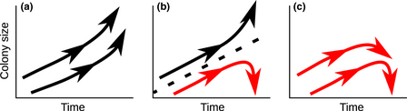
Colony dynamics
Less pesticide
The model predicts that for intermediate pesticide exposure, colonies can grow, or fail. We think this can explain the result of Cox-Foster (2007) http://onlinelibrary.wiley.com/doi/10.1111/ele.12188/full#ele12188-fig-0001
Notes:
A schematic diagram showing the changing types of dynamics in the SLS Model due to an increasing rate of healthy bees becoming impaired (β increases over the three panels from left to right). Colonies with black trajectories grow whereas red trajectories lead to failure. (a) All colonies grow. (b) There is a breaking point (dashed line) between two basins of attraction depending on the numbers of bees present in the colony and the level of impaired bees in the colony; depending on initial conditions colonies will either grow or fail. (c) All colonies can grow at first but will eventually fail.
© This slide is made available for non-commercial use only. Please note that permission may be required for re-use of images in which the copyright is owned by a third party.

Slide 52
Any stress (including disease) could cause alternative fates
Prevalence of 4 diseases in collapsing colonies
Cox-Foster et al. Science (2007): 318, 283-287

Slide 53
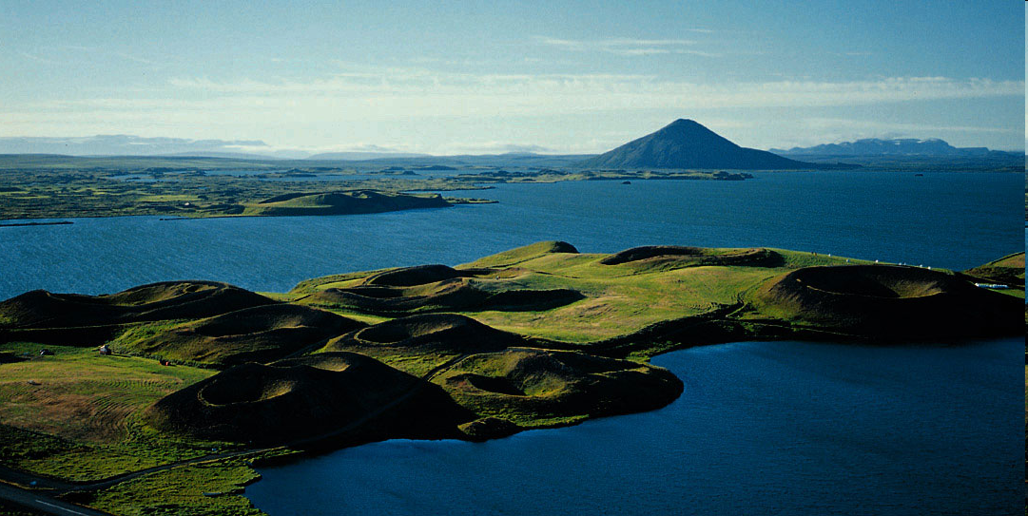
Lake Myvatn, Iceland

Slide 54
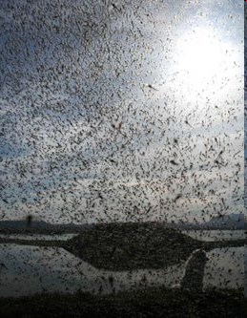
Midges can be highly abundant
Swarms ofTanytarsus gracilentus

Slide 55
From Ives et al. Nature 2008

Slide 56
Possible explanation: Alternative stable states

Slide 57
Demonstrating existence of alternative stable states
3 models are compared
Only the midge-algae detritus model has alternative stable states
This is best description given the data

Slide 58
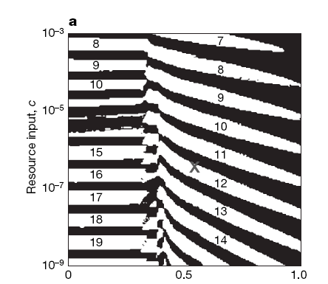
Parameter estimation
Conclusion: alternative stable states are a likely cause of the complex dynamics of the midges in Myvatn
White: alternative stable states
Black: only steady state possible

Slide 59
Learning outcomes
Understand how a change in carrying capacity can bring about a qualitative change
the difference between a phase transition and catastrophic transition
Understand the importance for ecosystems, management and conservation
Appreciate the issues regarding providing evidence for alternative stable states.

Slide 60
Period doubling, chaos
Vincent Jansen
vincent.jansen@rhul.ac.uk

Slide 61
Back to the logistic
A Drosophila population kept in the lab. Another logistic growth curve from the work of Pearl. (1927) Q. Rev. Biol. 2 532-548.

Slide 62
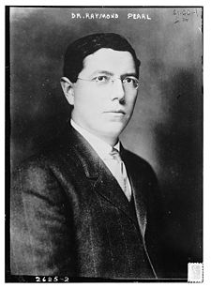
A quote from Pearl (1927)
“Many experiments of this type have been performed. The general result is that the population first grows up to a maximum or asymptotic level, …. A striking result, however, is that both during the growth period and thereafter there are violent oscillations of the populations in size, about its mean position as given by the fitted curve. In fact these waves in the size of the population, produced by oscillations in the birth and death rates, are perhaps the most characteristic feature of population experiments of this particular type. It has not so far been possible to devise any method of holding these populations in a steady state at the level of the asymptote, when there is at all times an abundance of fresh food. The population simply waves up and down about an average size. “

Slide 63
Back to the logistic
Remember, the continuous time logistic model assumes that the density dependence works immediately
For the fruit flies the effect of the density dependence is delayed
What is the effect of such a delay?
Notes:
Density dependence works on the larvae, but the effect is on the nr of eggs laid in the next generation.

Slide 64
Logistic Map
The discrete logistic model (also called logistic map) is given by
with r the maximum per capita growth rate and k the carrying capacity.

Slide 65
Logistic Map
rk
-rk

Slide 66
Logistic Map
For low values of rk the dynamics are very similar to those of the continuous growth model. (Value r=1 used in all the pictures)
_{k=1}
N_{t}
t

Slide 67
Logistic Map
If rk is bigger the dynamics begin to differ from the continuous time model
_{k=2.56}
_{k=2.05}
_{k=1.75}
_{k=2.5}
N_{t}
t

Slide 68
Logistic Map
The discrete logistic model (also called logistic map) is given by
with r the maximum per capita growth rate and k the carrying capacity

Slide 69
Logistic Map : finding the equilibrium
k

Slide 70
Logistic Map: Stability of the equilibria
We study the dynamics close to the equilibrium
The distance from the equilibrium is
The dynamics close to equilibrium are approximately:
If :
Note that if the multiplier is <-1 the equilibrium is unstable
Stable if 0<rk<2

Slide 71
Logistic Map: Stability of the equilibrium
N_{t+1}=f(N_{t})
k

Slide 72
Stability of the equilibrium
So what happens if the equilibrium loses stability?
The analysis suggests periodic oscillations. Does this settle into a stable pattern?
We can find the value for the next step from N_{t+1}=f(N_{t})
So after 2 steps we have
Is there an equilibrium that is reached if we look at every second step?

Slide 73
Logistic Map Period 2 cycle
_{k=2.00}
_{k=1.75}
_{k=2.25}

Slide 74
Logistic Map Bifurcation diagram

Slide 75
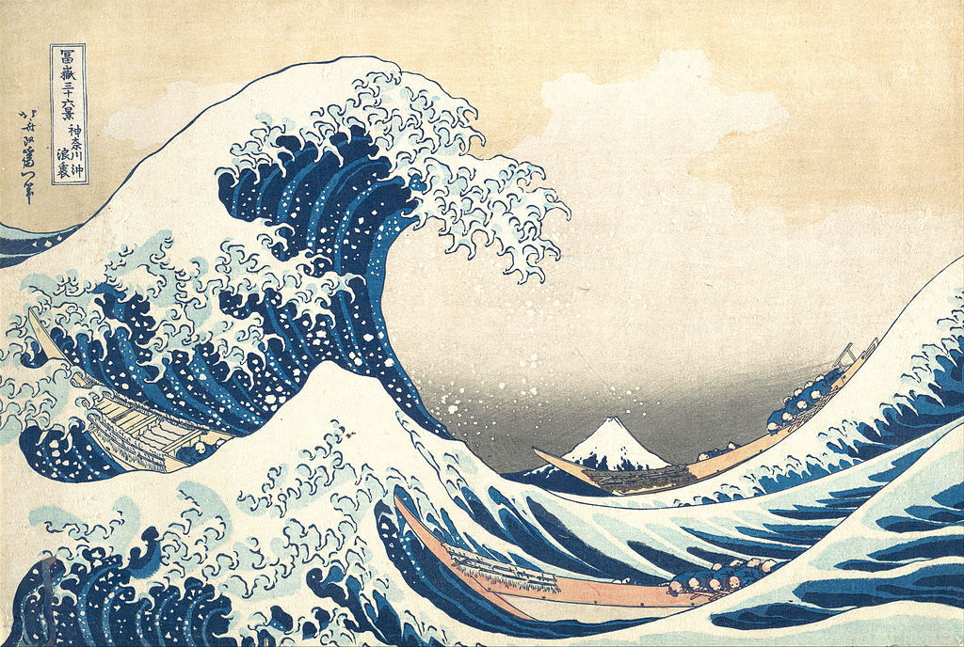
Logistic Map Bifurcation diagram
The equilibrium becomes unstable.
We can see limit cycles
We see the sequence
Overcompensation->Period 2 cycles
->Period 4 cycles->Period 8 cycles
What next?
After going through the period doubling cascade one finds chaos

Slide 76
Practical 2:Make a bifurcation diagram for the logistic map.

Slide 77
Logistic Map Bifurcation diagram

Slide 78
Chaos
_{k=2.56}
log(difference red and black plots)
N_{t}
t

Slide 79
Chaos
_{k=2.65}
N_{t}
log(difference red and black plots)
t

Slide 80
Chaos
Why does chaos matter in biology?
It shows that unpredictability can follow even if you know exactly how one generation depends on the next
There are limits to what we can predict, (because we cannot know the present conditions with sufficient precision)

Slide 81
Practical 2: Investigate the dependence on initial conditions, and how it affects the predictability of the logistic map.

Slide 82
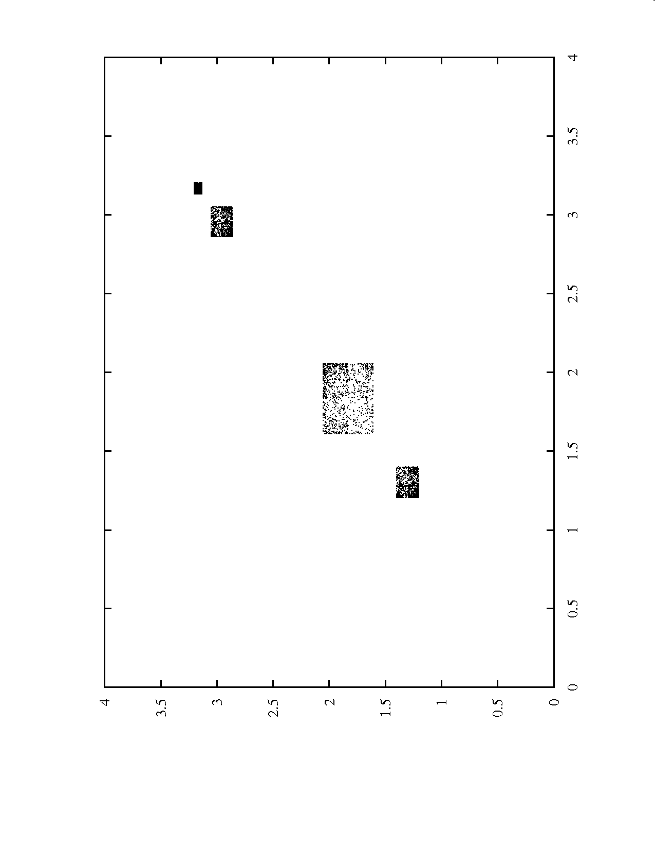
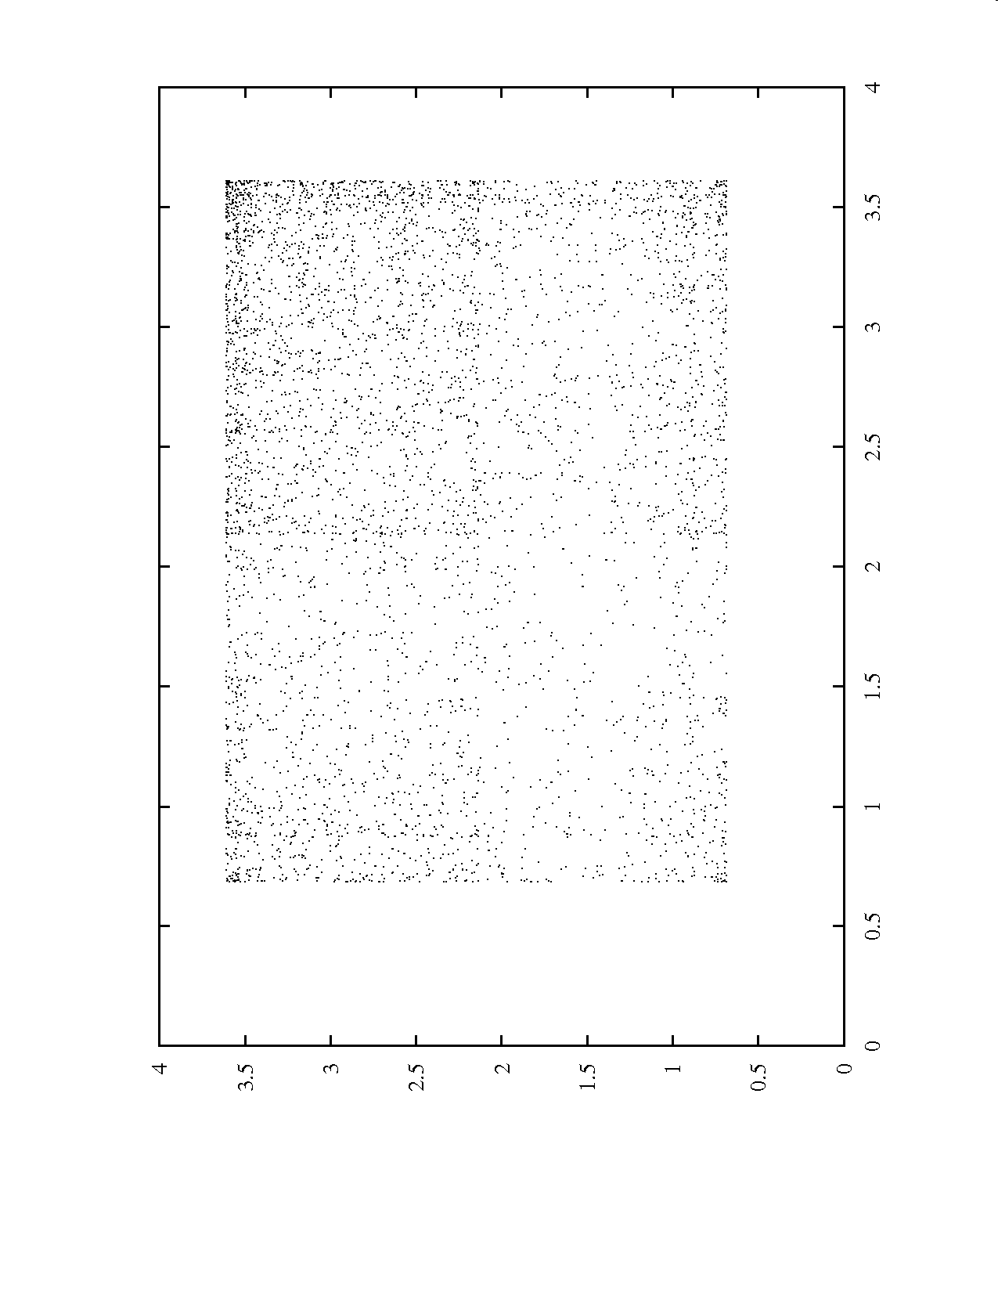
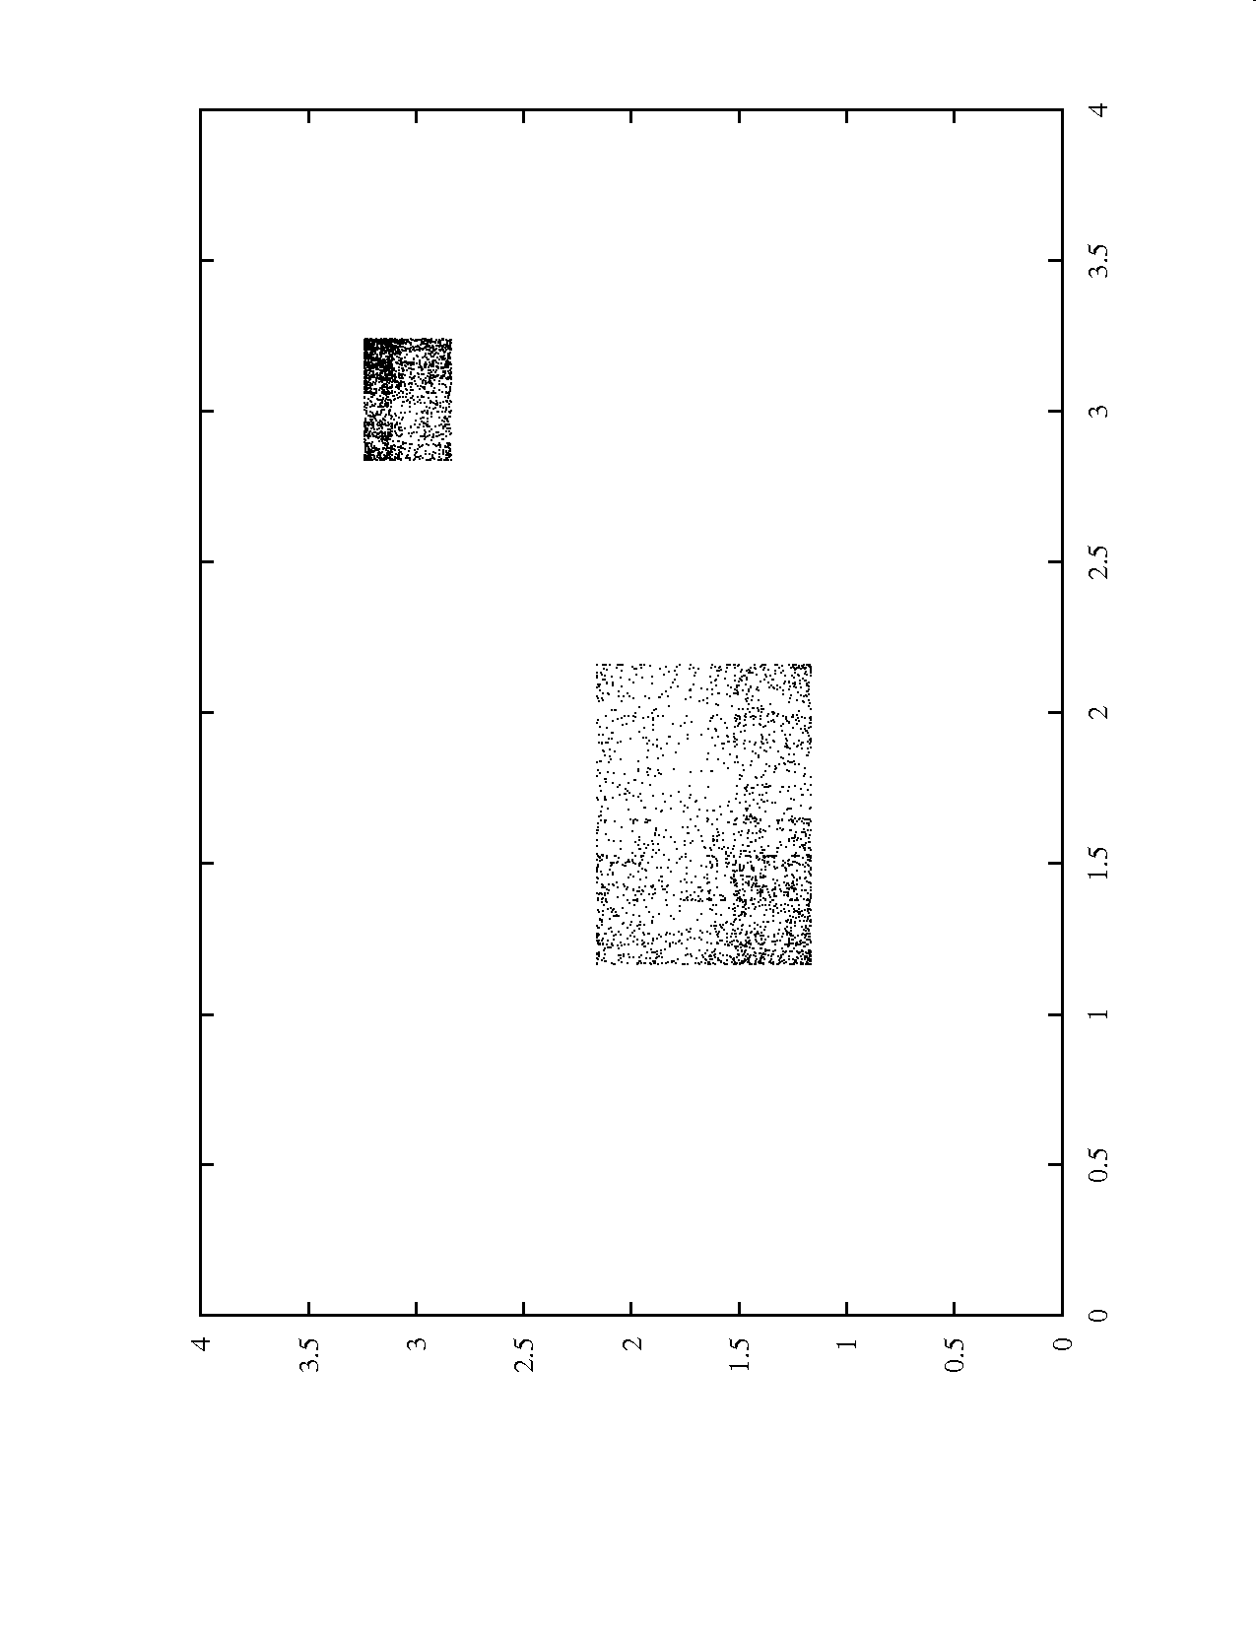
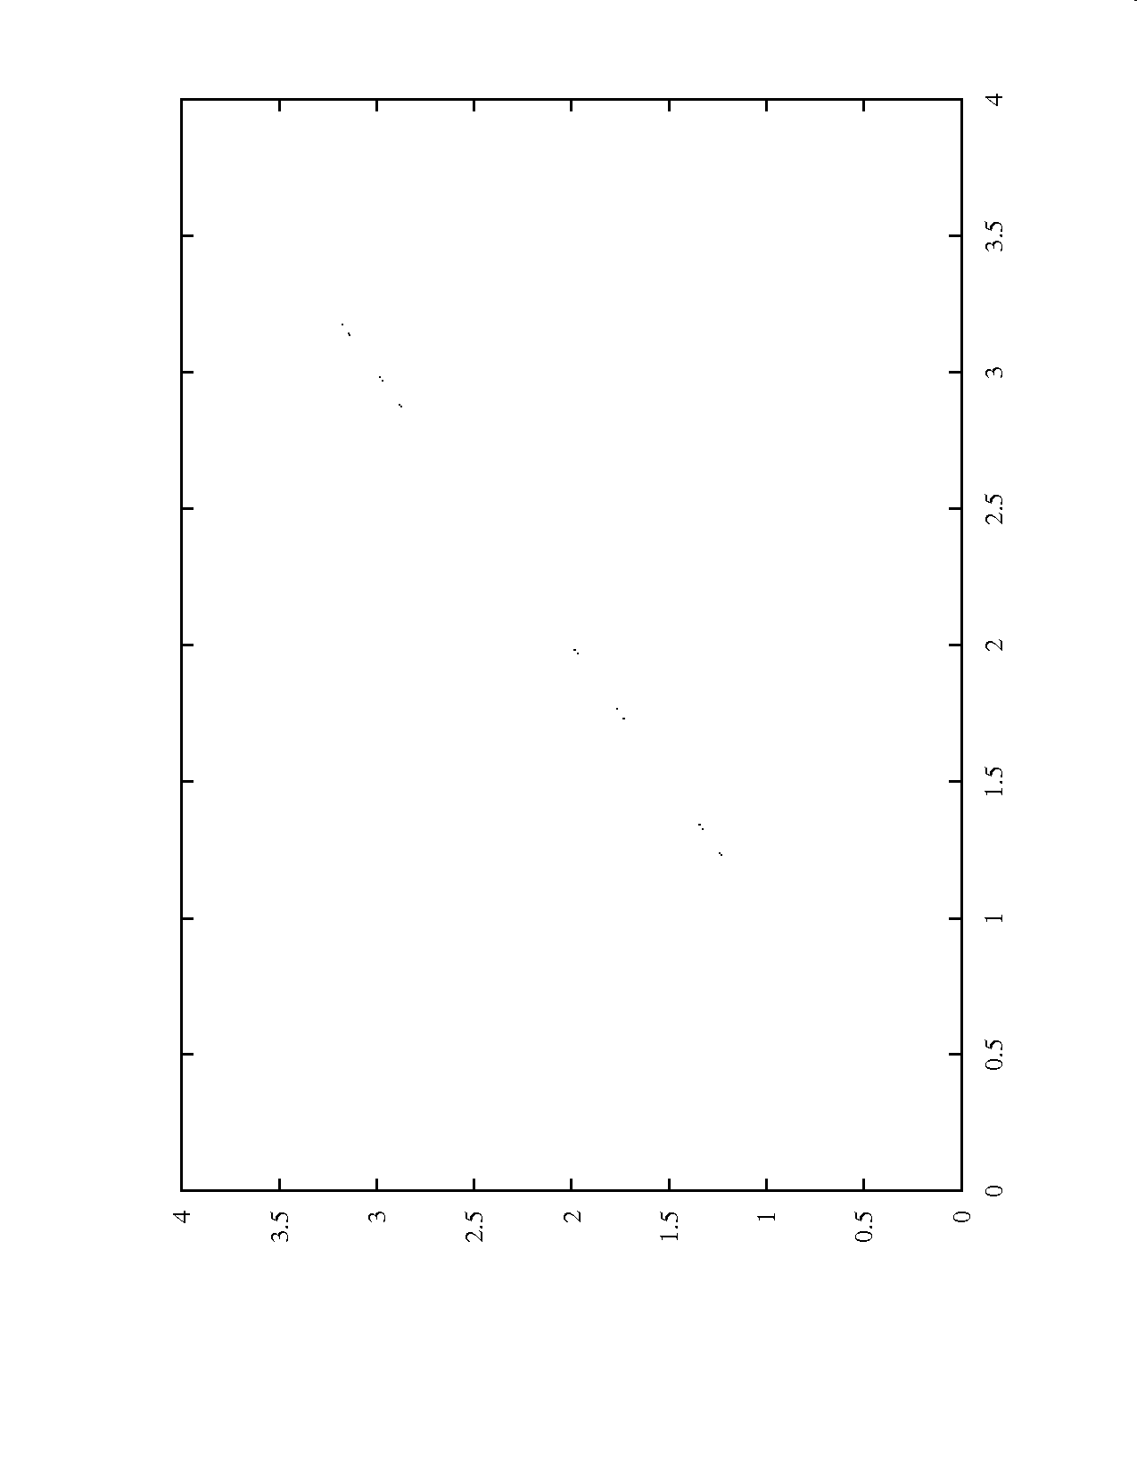
k=2.8
k=2.58
k=2.6
k=2.55
predicted
observed

Slide 83
Chaos
Are population dynamics chaotic?
There is an example of a single species laboratory system of which the dynamics seem chaotic

Slide 84
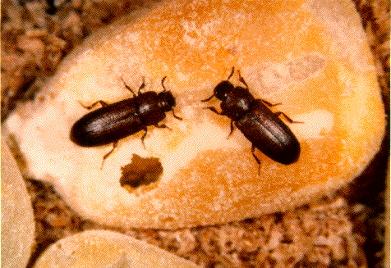
Chaos
Notes:
Results on the flour beetle Tribolium. By manupulating adult mortality rate the dynamics can be changed. The model predicts different types of behaviour for different levels of manipulation. Manipulation starts at week 12.

Slide 85
Chaos
There are some indications that other systems, with more species are chaotic
Beninca et al. isolated a marine ecosystem and kept it in the lab. They found:
Notes:
Conclusion: foodwebs that persist in nature can still be chaotic. Stability is not required for persistence

Slide 86
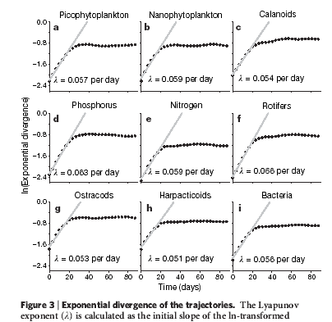

Chaos
Notes:
Conclusion: foodwebs that persist in nature can still be chaotic. Stability is not required for persistence

Slide 87
Learning outcomes
Simple models can have complicated dynamics
Even if you know exactly how things work, it doesn’t mean you can predict them in the long term

